Slide 1
Fate Of Stars In Andromeda Galaxy At Sun’s Location
Rafia Bushra
Undergraduate Student
Steward Observatory

Slide 2
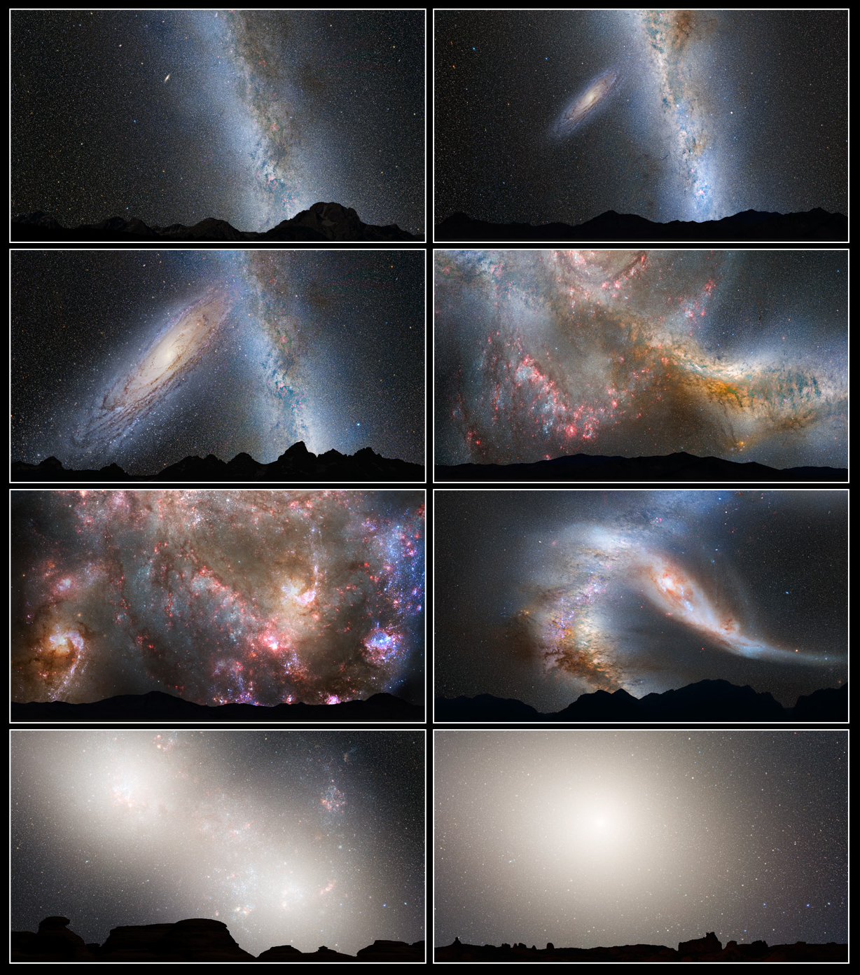


Overview - Milky Way & Andromeda
Similar size
Both spiral and barred
Galaxies
M31 a little more massive
Current separation about
2.5 Mly
On a head on collision course!
Approaching us at
[Marel, 2012]
Rendering of how the collision might look from an Earth-like planet (Credit: NASA, ESA, Z. Levay, R. Van Der Marel (STSci), T. Hallas, A Mellinger)

Slide 3
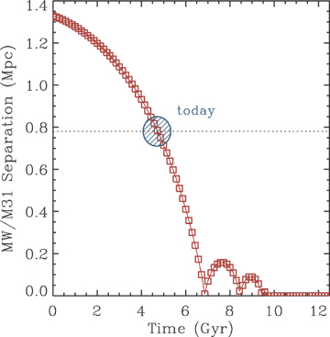
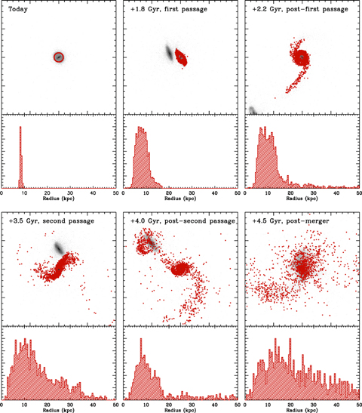
Why This Is Important
[Cox & Loeb, 2008]

Slide 4
Questions I want to explore
Position of the sun analogs as a function of time
What does the trajectory look like?
Do they move further away from the galactic center or closer in?
Kinematics of the sun analogs as a function of time
How does the kinematics change over time?
Do they become unbound?
If so, what percentage becomes unbound?
After collision
Do any of them get transferred to Milky Way or M33?
Does the trajectory change?

Slide 5




My Approach - Selecting Analogs
Use the simulation of M31 to identify particles that:
Are at the right distance from galactic center
Use an annulus centered at R = 8.29 kpc
Use annulus width of ±0.1R (ie. ~ 7.46kpc - 9.12kpc)
Have the right circular velocity on the equatorial plane
Sun’s circular velocity at R:
of candidates should be within
Have the right out-of-plane velocity

Slide 6
My Approach - Determining Analog Parameters
CenterOfMass.py - developed in HW4
Find position at each snapshot (trajectory)
Find velocity at each snapshot (kinematics)
The unbound question
Calculate escape velocity of galaxy
Is the velocity of analog higher than the escape velocity
What fraction of the analogs have a velocity higher than the escape velocity
After collision
Track position & velocity as before
Are some of the analog positions where MW or M33 should be?
What fraction of the analogs transferred to MW or M33?

Slide 7
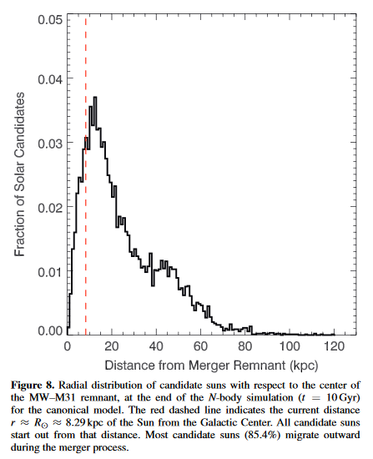
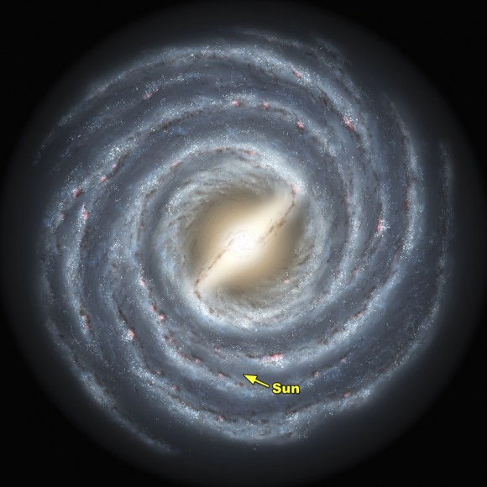
Hypothesis of the outcome
Stars won’t collide into each other
Most of the analogs will survive
They will move further out from 8.29 kpc
Some might be unbound
Some might be transferred to MW or M33
Map of the Milky Way. Image credit: Caltech
Van Der Marel ET AL.

Slide 8
Thank You
I am happy to take questions or feedback

